Slide 1

ReSet Partnership
Overview

Slide 2
What is a Fiscal Sponsor?
A fiscal sponsor is a nonprofit organization that provides its tax-exempt status, financial management, and administrative support to another project or group that does not have its own 501(c)(3) designation, allowing that project to receive tax-deductible donations and grants while focusing on its mission.

Slide 3
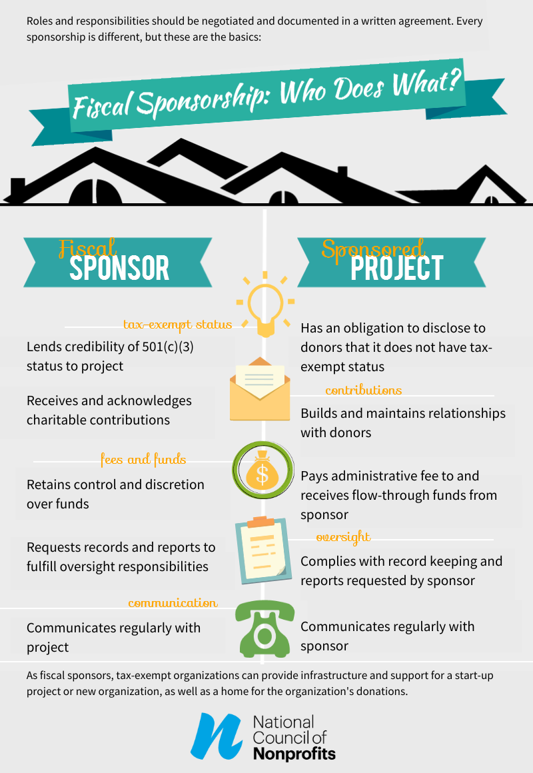
Responsibilities
Overview

Slide 4









ReSet Support Team
Executive Director Carola Bracco
Deputy Director Jeanette Gisbert
Chief Financial Officer
Kathy Thorsberg
Chief Development Officer
Adrienne Vogel
Senior Accounting Manager
Debbie Hubbe
Accounting Manager
Anne Marie Curreri
Development Officer
Cesar Zepeda
Communications and Social Media Manager
Katie Graves-Abe
Development Associate
Rina Lokaj

Slide 5
Oversight
Monthly meeting with ReSet treasurer
  Governance
  Program compliance
  Risk management
  Knowledge sharing
Frequent communication between scheduled meetings with ReSet Board Chair and Treasurer
Attend annual ReSet Board Meeting
Attend annual fundraiser
Financial Oversight
  Monthly financial statements
  Monitor expenses
Notes:
Governance is essential for managing a fiscal sponsor. The sponsor’s board of directors has a fiduciary duty to ensure that the sponsor operates in line with its mission, complies with legal and regulatory requirements, and manages its financial resources effectively.
The sponsor must ensure that their sponsored projects align with the sponsor's mission and comply with all applicable laws. This includes managing risks associated with projects, including legal, financial, and reputational risks. The sponsor also has responsibility for supporting sponsored projects, ensuring the project adheres to best practices and complies with the sponsor’s standards. While the sponsor’s board is not going to be involved in the day-to-day of that work, the directors have a fiduciary duty to make sure that that sponsor’s leadership and staff are doing that work, and holding projects accountable.

