Slide 1

Annual Program Data Report: 2025
Board Snapshot

Slide 2
2025 at a Glance - Impact and Resilience
2025 was a year of resilience and strategic adaptability amid unprecedented increased complexity in all aspects of our work.
Over 10,000 people served for the second year in a row. Overall clients served declined modestly (–4%), as a result of more complex immigration cases rather than diminished demand.
Legal Services
  Nearly 2,900 unique clients served with an 84% success rate.
  Case complexity increased (asylum prep time +44%).
Family & Individual Support
  22% increase in unique clients, despite fewer total cases.
  Increased case complexity resulted in added in person office hours and supervision.
Workforce Development & Economic Mobility
  Carreras y Caminos served 1,028 clients (+9%).
  Business Center clients increased 24%, with cases up 32%, signaling demand for entrepreneurship and workforce development.
  ESL participation increased, with completion rates exceeding national averages.

Slide 3
2025 at a Glance - Community Education, Volunteers and Influence
Neighbors Link expanded its reach, and impact by leveraging Community Education, volunteers, and partnerships as force multipliers.
Community Education and Empowerment
  188 trainings and events (+84% from 2024).
  11,154 people reached.
  60% more immigrant clients, 13× more providers, and nearly 4× more allies engaged.
Volunteers
  882 volunteers (+8%).
  Legal volunteers nearly quadrupled; service hours nearly tripled.
  Volunteers delivered 39% of total service hours in legal work.
Advocacy & Visibility
  Active leadership in statewide and local immigrant issue related campaigns.
  Expanded social media reach, expanding mission delivery.

Slide 4
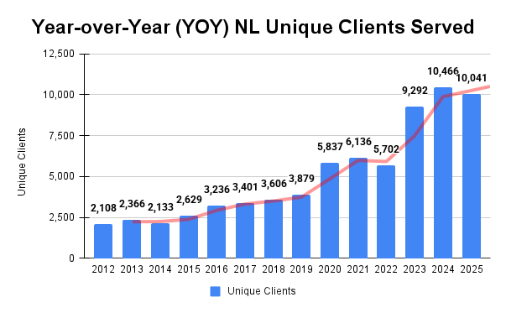
Neighbors Link: Overall Clients Served by Year
Neighbors Link has experienced steady long-term growth in clients served. In 2025, while overall unique client served declined modestly (–4%) due to increased case complexity and significant immigration policy changes, the organization maintained strong outcomes and deepened its impact.

Slide 5
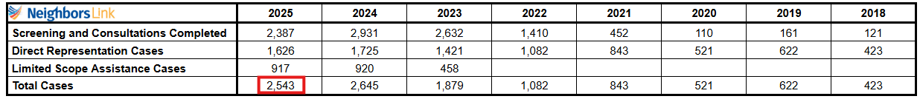
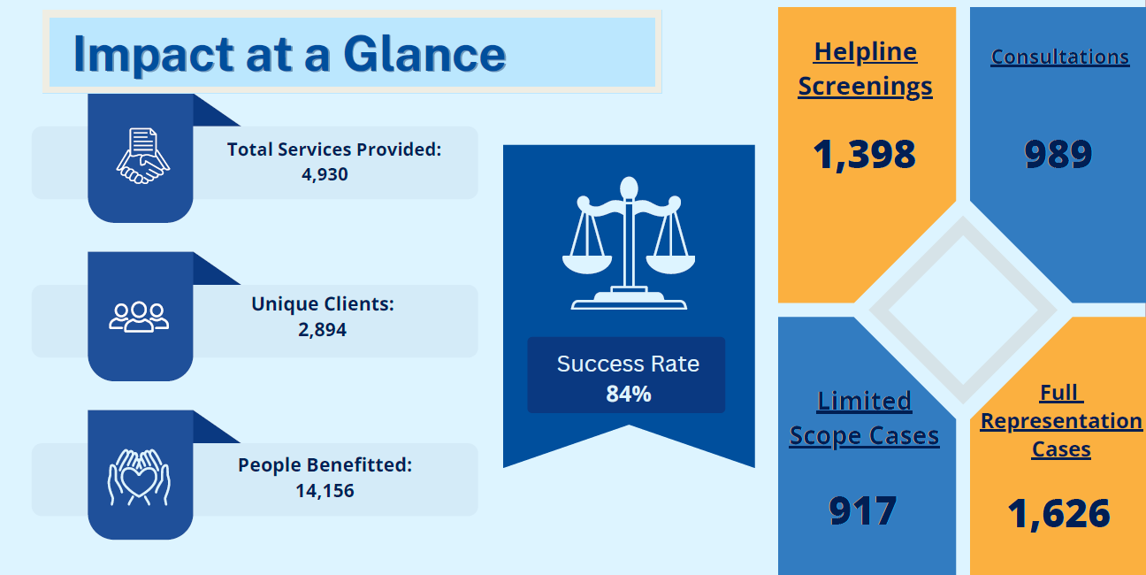
Legal Services 2025
Continuing to offer limited-scope services allows our legal team to efficiently assist our clients.

Slide 6
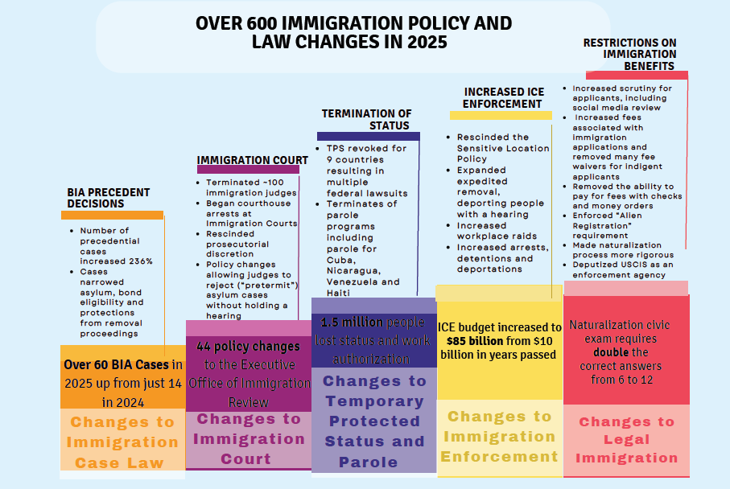
Legal Services 2025

Slide 7
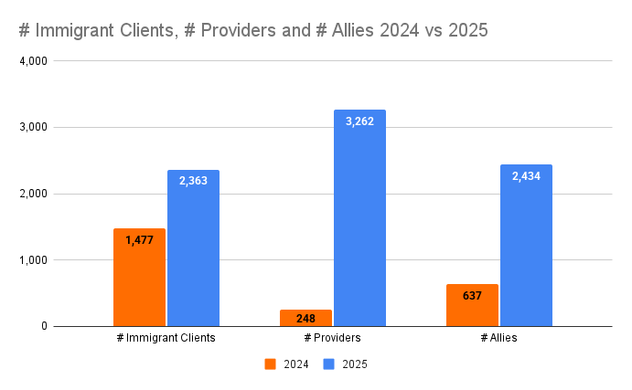
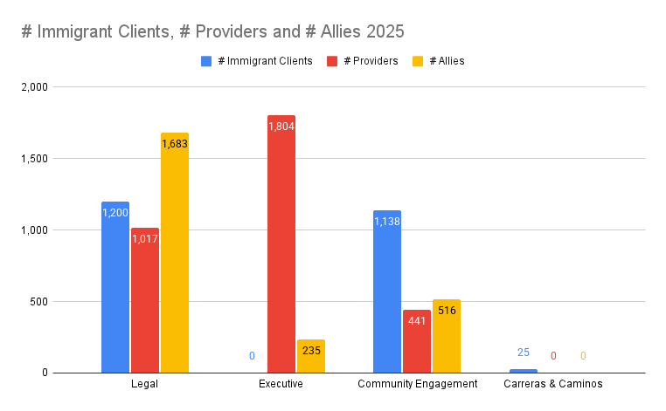
Community Education 2025
Training Programs & Presentations
 | # Sessions/Events | Total # People Reached | # Clients | # Providers | # Allies | # Social Media Participants
2025 | 188 | 11,154 | 2,363 | 3,262 | 2,434 | 3,095
The expertise of our staff is sought out by partners, allies, and immigrant community members alike. Neighbors Link developed content and lead 188 special topic training sessions and reached over 11,154 people. Our 2025 sessions are primarily In-person (86%), virtual (14%).
Comparison between 2024 and 2025 numbers:
60% increase in Immigrant Clients reached.
13 times increase in Providers reached.
Nearly 4 times increase in Allies reached.
84% increase in number of events. From 102 events in 2024 to 188 in 2025.
Type of Events and Presentations:
Know Your Rights Presentations
Community Education
Post Election Update
Cultural Awareness Trainings
Trainings and Presentations
Programs info sessions
Legal Clinics, Safety Plan Clinics
Community Halls & Meetings/ Round table events
Cultural and Community events
Webinars

Slide 8
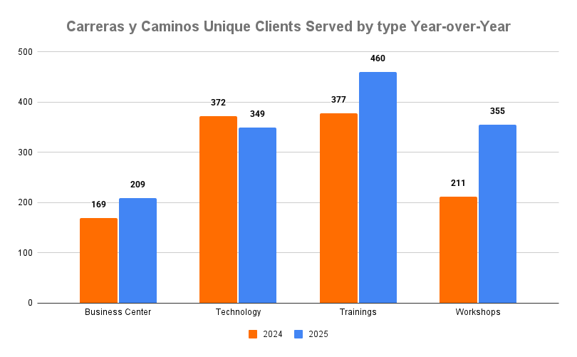
Carreras y Caminos 2025
In 2025, Carreras y Caminos served 1,028 unique clients. 9% more than the previous year.
Technology: Tech-Education, Technology Skills for Beginners and Advanced, One-on-One Tutoring Classes.
Trainings: Small Business, OSHA 30, Site Safety, CPR/First Aid, Eco Cleaning, Entrepreneur, Prevention of Conflict at workplace, Adult care, Culinary, Child care, Admin assistance, Construction trades, Workplace readiness, Mixology, CMA, Financial, Flagger, Interview Preparation, NCCER, Painting.
Workshops: Career Development Series, Trainings & Job connections, Financial literacy, Small business, Tax information.

Slide 9
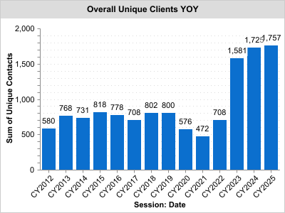
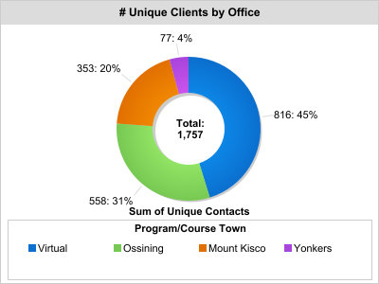
ESL 2025
ESL program participation has remained high for three years. 2025 showed a 2% increase compared to 2024.
45% of the ESL students attended virtually and 55% were in-person across the all 3 centers.
Virtual participation increased 26% compared to 2024

Slide 10
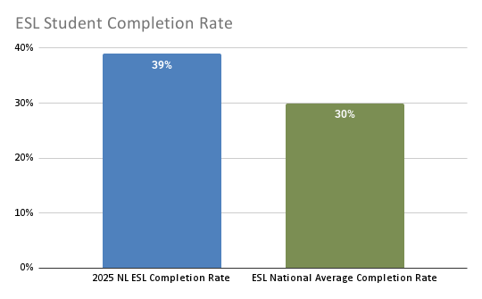
ESL 2025 - Student Completion Rate
Our students exceed nat’l avg of about 30% class completion rates

Slide 11
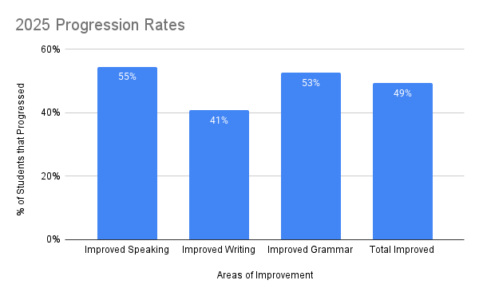
ESL 2025 - Student Progress
55% of students improved in their speaking, 41% in writing and 53% in grammar

Slide 12
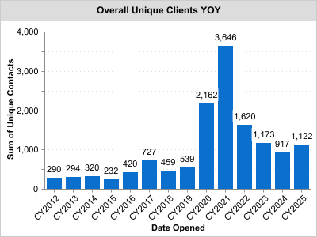
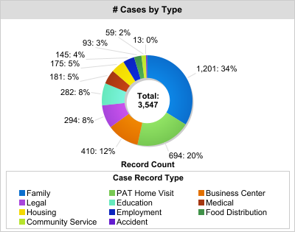
Family Center 2025
Family & Individual Support Services
In 2025, there was a 22% increase in unique clients served compared to 2024, and a 24% decrease in the total number of cases. This decline was largely driven by the conclusion of a COVID-era food distribution program.
Family and Individual Support Services include 1:1 services offered in Migration Assistance Program (MAP), Parents As Teachers (PAT), Carreras y Caminos, Food Distribution, Community Service and crisis interventions.

Slide 13
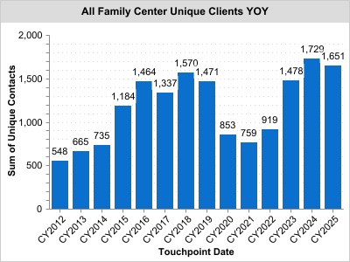
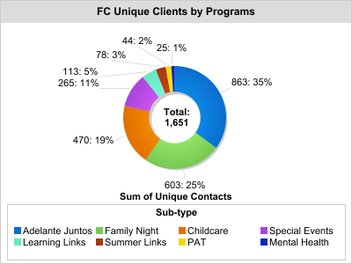
Family Center 2025
Programs
After experiencing several years growth between 2022 and 2024, the Family Center served 1,651 in 2025, a small 4.5% decrease in program participation from 2024, which is primarily attributed to a minor decline in the number of children that parents brought with them for childcare. Adelante Juntos continues to be the most attended program of the Family Center, having served 863 parents and young children in 2025, a slight increase over the 856 total individuals served in 2024.

Slide 14
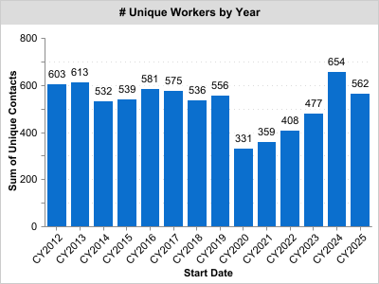
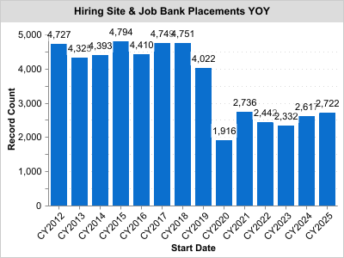
Worker Center 2025
Job Placements
In 2025, job placements saw a 4% increase compared to 2024. However there was a 14% decrease in unique workers and an 8% decline in unique employers.

Slide 15
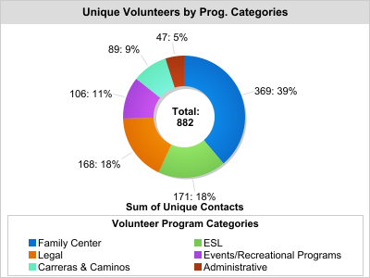
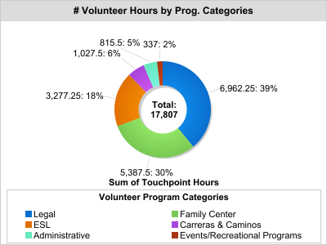
Volunteers 2025
882 volunteers. Volunteer participation increased 8% compared to 2024.
Family Center category had the highest number of unique volunteers (369), 39% of the total unique volunteers (882).
Legal category had the highest number of volunteer hours (6,962), 39% of the total hours (17,807).

Slide 16
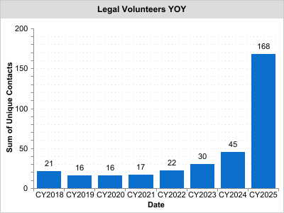
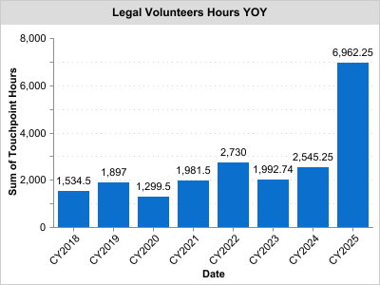
Legal Volunteers 2025
168 Volunteers. Legal volunteers nearly quadrupled; service hours nearly tripled.
The number of unique Legal Volunteers nearly quadrupled.
Total Legal Volunteer service hours nearly tripled.

Slide 17
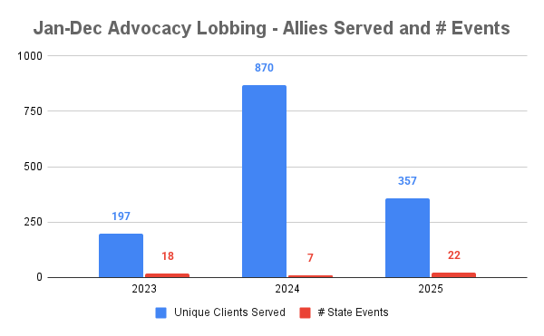
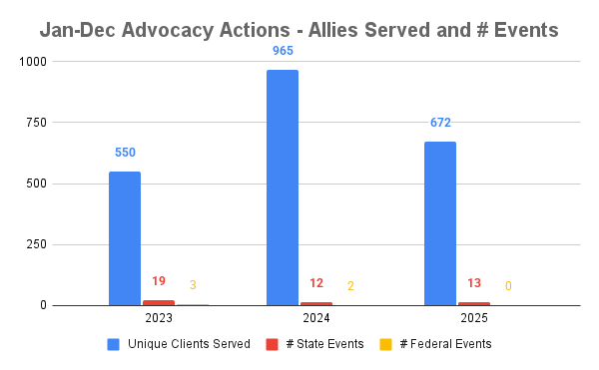
Advocacy 2025
 | # Advocacy Lobbying Events | # State Events | # County Events | # Local Events | # Allies
2025 | 22 | 22 | 0 | 0 | 357
 | # Advocacy Action Events | # Federal Events | # State Events | # County Events | # Local Events | # Allies
2025 | 14 | 0 | 13 | 0 | 0 | 672
Neighbors Link strongly supports budgets and policies that respect the dignity of each human and recognize the contributions made by immigrants. In 2025 we supported different key legislative and/or budget issues campaigns that will lead to a more equitable community. Also, we participated in Vigil to Support Immigrant Families.
Advocacy Campaigns:
Coverage for All
New York for All
Representation Act & Legal Service Funding
Welcoming New York / New Arrivals
Language Access
Desde Abajo Labor Enforcement (DALE)
NYS Housing Access Voucher Program (HAVP)
NY Working Families Tax Credits
Unemployment Bridge Program
Care4 Immigrant Families
Fairness to Freedom Act
Building up immigrant legal defense Act (Build Act)
Access to Representation Act (ARA Act)

Slide 18






Social Media Overview 2025
In 2025, we saw an increase in clients receiving information, such as Program Posts and Grant & Legislative Posts, via social media increasing its’ importance as a mission delivery strategy.
5,974 followers
Audience: Broad mix of clients, donors, allies, community partners
From Jan 2025 to Jan 2026, we had an increase of 699 followers
2,840 followers
Audience: Mostly donors, allies, and community partners, clients
From Jan 2025 to Jan 2026, we had an increase of 527 followers
844 followers
Audience: Employees, Board Members, Friends, Community partners, donors, allies
From Jan 2025 to Jan 2026, we had an increase of 240 followers
We have accounts on Bluesky and Threads, but are not very active there.
149 subscribers
Currently mostly used to upload videos to share on other platforms

Slide 19
Thank you!

