Slide 1

ReSet Partnership Overview
Board Presentation April 2026

Slide 2








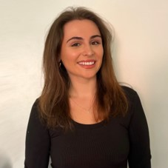
ReSet Support Team
Executive Director Carola Bracco
Deputy Director Jeanette Gisbert
Chief Financial Officer
Kathy Thorsberg
Chief Development Officer
Adrienne Vogel
Senior Accounting Manager
Debbie Hubbe
Accounting Manager
Anne Marie Curreri
Development Officer
Cesar Zepeda
Communications and Social Media Manager
Katie Graves-Abe
Development Associate
Rina Lokaj

Slide 3
Oversight
Neighbors Link maintains hands-on oversight to ensure compliance, financial integrity, and mission alignment.
Monthly meeting with ReSet treasurer
  Governance
  Program compliance
  Risk management
  Knowledge sharing
Frequent communication between scheduled meetings with ReSet Board Chair and Treasurer
Attend annual ReSet Board Meeting
Attend annual fundraiser
Financial Oversight
  Monthly financial statements
  Monitor expenses
Notes:
Governance is essential for managing a fiscal sponsor. The sponsor’s board of directors has a fiduciary duty to ensure that the sponsor operates in line with its mission, complies with legal and regulatory requirements, and manages its financial resources effectively.
The sponsor must ensure that their sponsored projects align with the sponsor's mission and comply with all applicable laws. This includes managing risks associated with projects, including legal, financial, and reputational risks. The sponsor also has responsibility for supporting sponsored projects, ensuring the project adheres to best practices and complies with the sponsor’s standards. While the sponsor’s board is not going to be involved in the day-to-day of that work, the directors have a fiduciary duty to make sure that that sponsor’s leadership and staff are doing that work, and holding projects accountable.

Slide 4
ReSet Westchester Board Members
﻿Linda R. Burpee
Beverly Busman
MaryAnn Carr
Gary Cohn
Linda Dishner
Neil Klar
Norma Klein
Elaine Gloth Merker
Elyssa Michaels
Heidi G.C. Rieger
Emmett Seaborn
= Also a NeighborsLink Donor
Notes:
There are several ReSet Westcehster Board Members who also support NL.
In addition to the Board thee use a committee structure such as governance and volunteer coordination to accomplish their work.

Slide 5
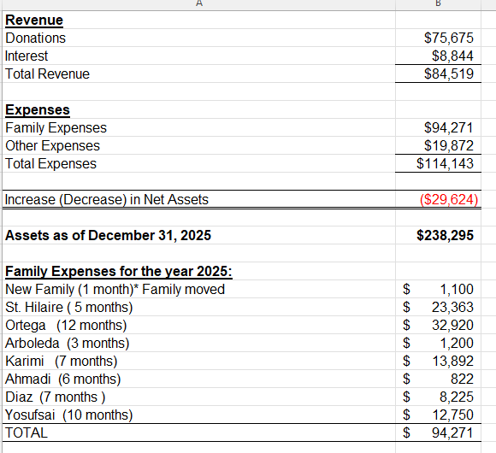
2025 Year End Financials
﻿
Other Expenses Include:
Neighbors Link Admin fee ($15,000 annually)
Insurance
Technology
Credit Card Processing

Slide 6
2025 Impact and Next Steps
In 2025, ReSet supported 8 refugee families with financial assistance, ESL navigation, and accompaniment to court appearances — 2 families continue to be actively supported today.
Like all refugee-serving organizations, ReSet is navigating a challenging policy environment — and remains committed to the families they are supporting.
ReSet is all volunteer run which means their costs to operate are relative modest.
We want to keep their volunteers connected and engaged so that the program is positioned to scale quickly if/when the landscape changes.
Shared donor community — supporting this program reinforces our credibility with funders who care deeply about immigrant issues.
Notes:
The refugee-serving landscape is under strain right now, with policy changes impacting their ability to serve.
Our ReSet partners are all volunteer-run, which means their cost structures are modest and their continued operation requires relatively little financial support.
We are in discussions with them about how we keep their volunteers connected. One benefit of doing so is that we keep a keep a dedicated pool of immigrant-serving volunteers engaged. Should/when the policy environment these programs are positioned and ready to scale quickly. We won't be starting from scratch.
There is meaningful overlap between the donor bases of ReSet and our own supporters. Maintaining these relationships reinforces our credibility with a community of funders who care deeply about immigrant issues.

Slide 7
What is a Fiscal Sponsor?
A fiscal sponsor is a nonprofit organization that provides its tax-exempt status, financial management, and administrative support to another project or group that does not have its own 501(c)(3) designation, allowing that project to receive tax-deductible donations and grants while focusing on its mission.

Slide 8
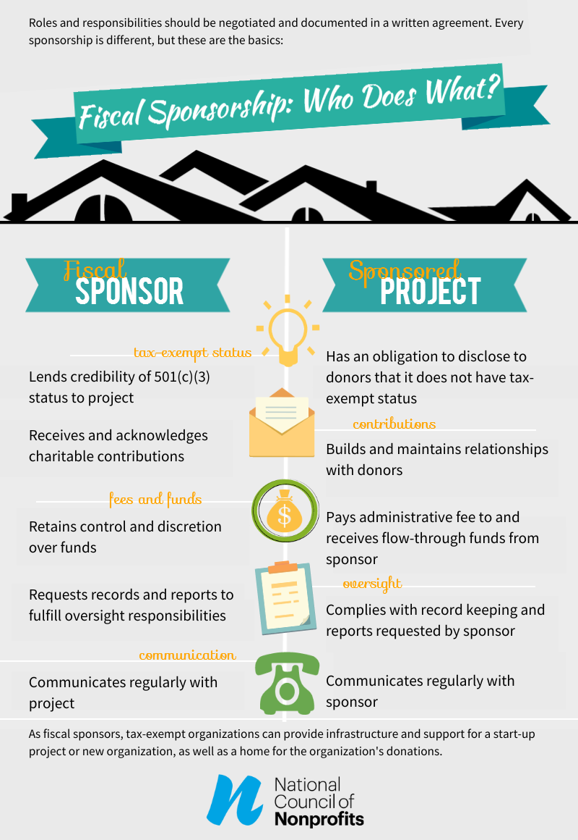
Responsibilities
Overview

