Slide 1
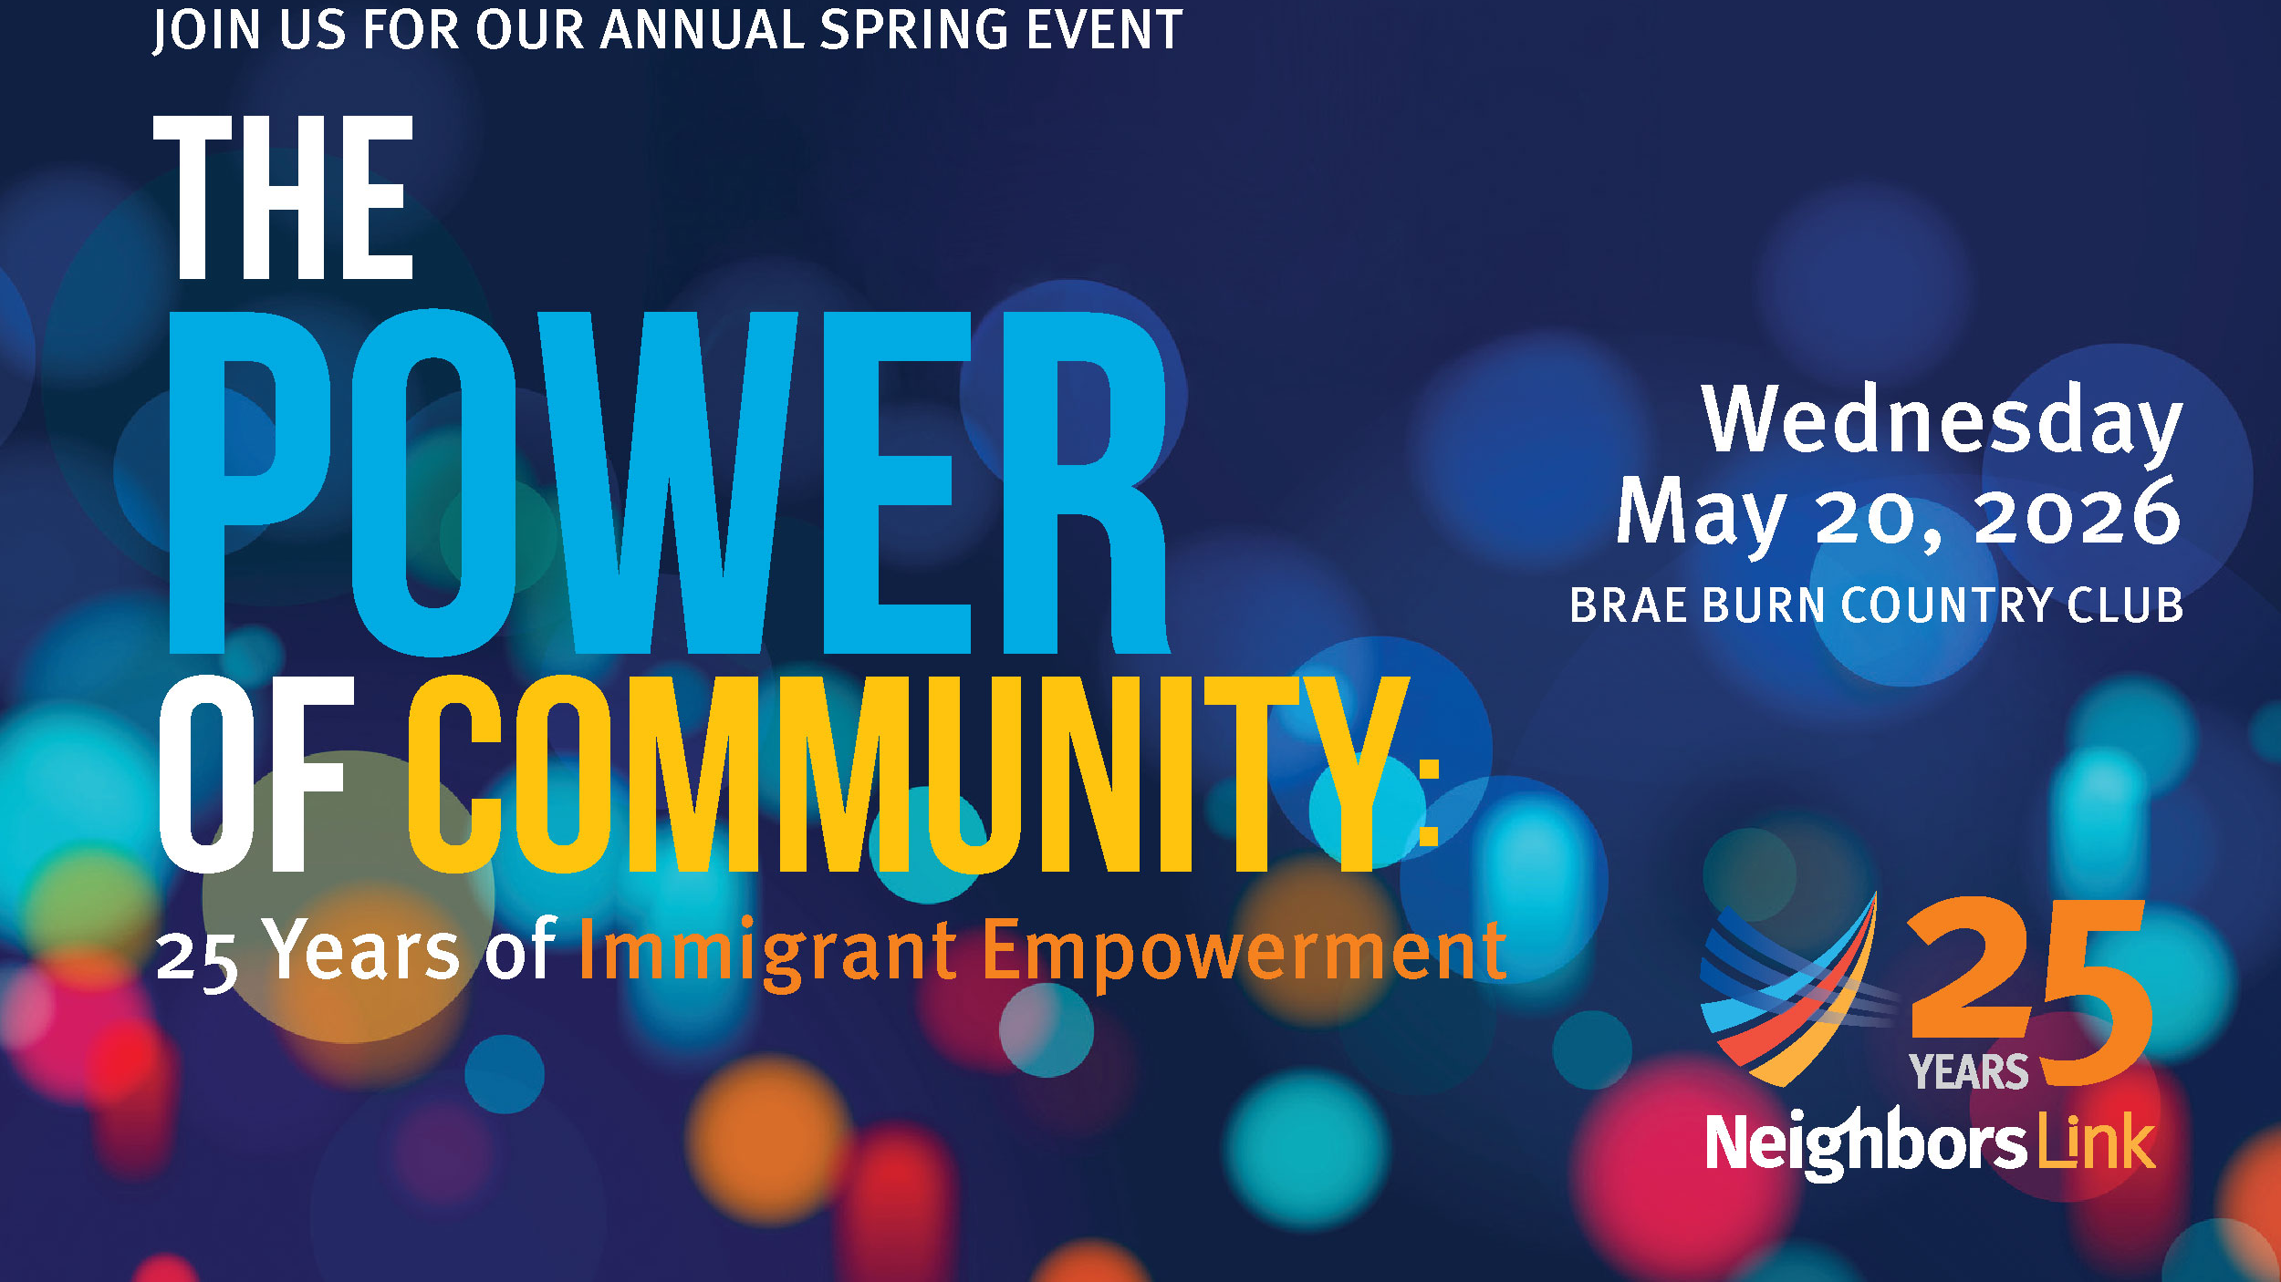

Slide 2

Net vs. Gross Revenue by Year

Slide 3
Cost to Raise a Dollar By Year
*According to NonProfit PRO, the national average cost to raise $1 through special events is $0.50
Neighbors Link calculation does not include an allocation of staff costs. It is unclear how much of staff costs
are included in the national average.”

Slide 4
Gross Revenue by Category (2025 vs. 2026)

Slide 5
Paddle Raise Revenue by Year

Slide 6
Number of Paddle Raises by Year

Slide 7
Average Paddle Raise Amount by Year

Slide 8
Paddle Raise Participation Rate

Slide 9
Key Points - Why the Event Was Successful
Honorees inspired extraordinary support.
Exceptional Board Leadership - Board members demonstrated their commitment through generous giving and fundraising. 100% of the Board supported the event.
Strong Participation from the Friends of Neighbors Link.
Impactful Program and Storytelling: Every element of the program was thoughtfully designed to showcase the impact of Neighbors Link in our community.
Notes:
Through their leadership and personal outreach of our honorees, Andrea and Bruce Yablon and Rabbi Aaron Brusso each helped generate more than $200,000 in support.
Collectively, the Board and your networks generated more than $250,000 in support.
The Friends and their networks expanded our reach. Their efforts resulted in more than $150,000 in revenue.
Client stories read by staff members, Jeffrey and Cynthia, resonated deeply with guests, providing powerful examples of the challenges and experiences our clients face every day.
Speakers delivered compelling remarks that underscored the urgent and growing needs facing our immigrant neighbors.

Slide 10
Moment of Light
As we marked 25 years of Neighbors Link, we created a visual and meaningful tribute to everyone who has been part of Neighbors Link's journey.
The room went dark as attendees were invited to turn on a flashlight that we handed out to guests.
Together, we counted down through key milestones in Neighbors Link's history. Highlighting those who have been involved for more than 20 years and the new supporters who joined in last 18 months.
With each milestone, more lights illuminated the room until it was filled with a powerful glow that represented the Power of Community.

Slide 11
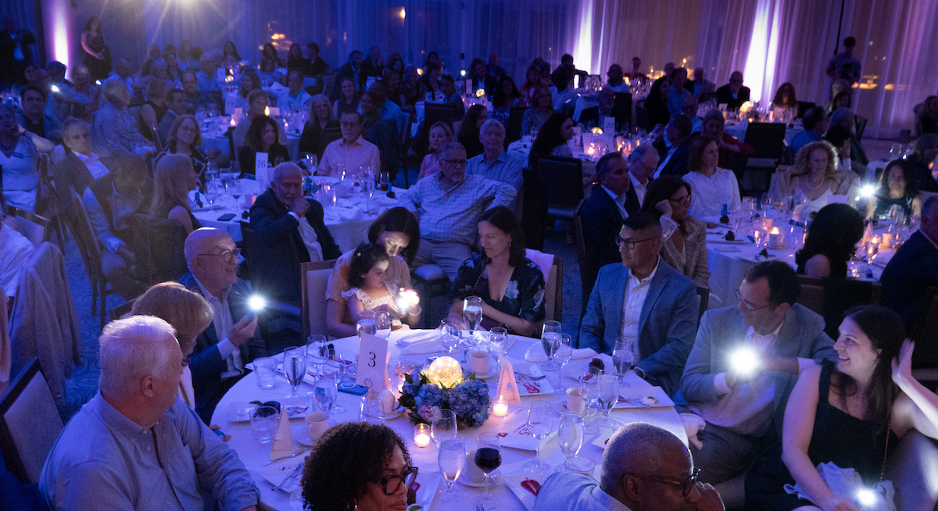
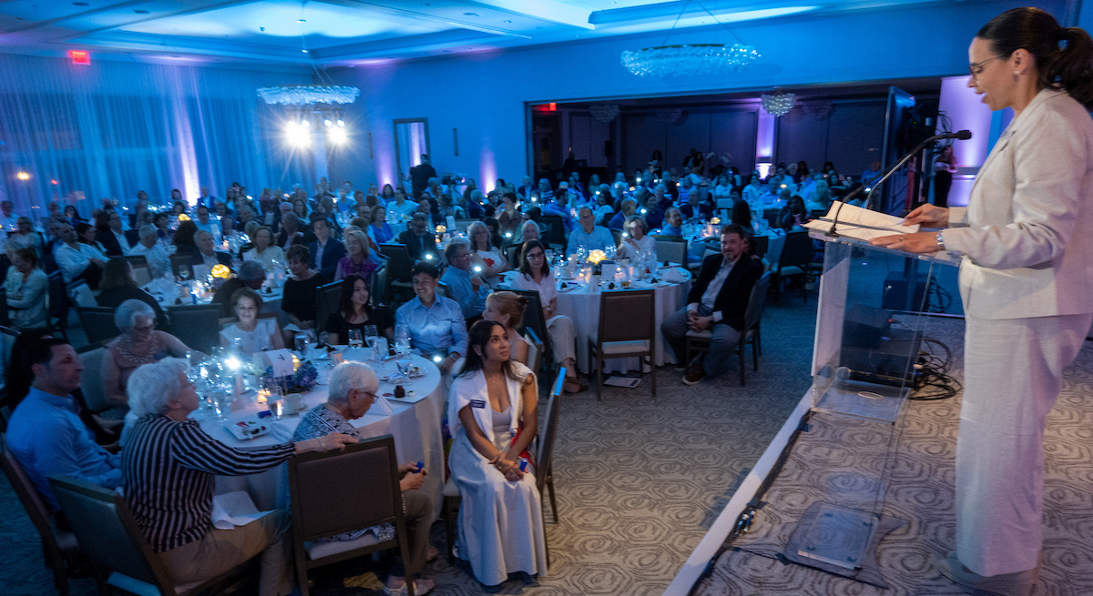
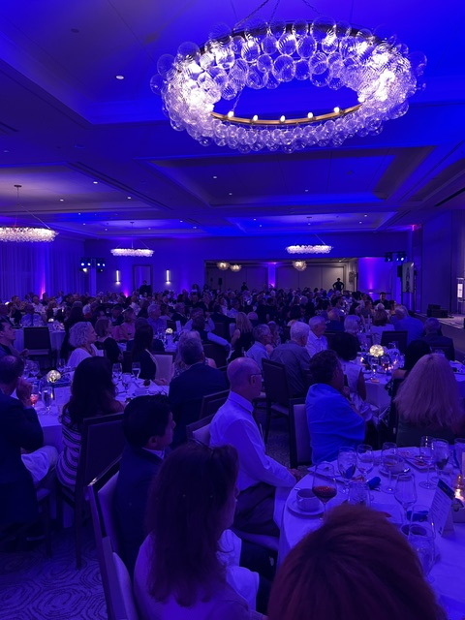
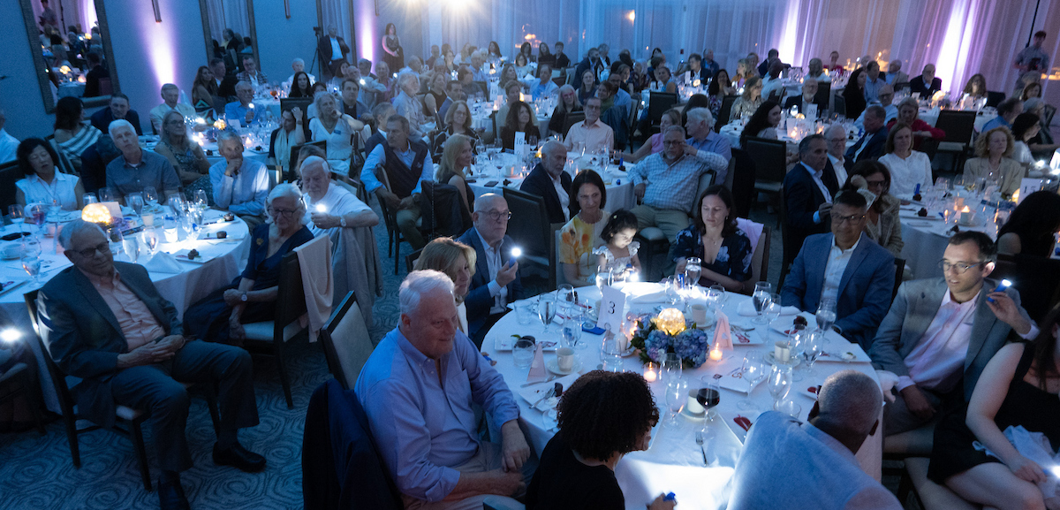

Slide 12
Save the Date – Spring Event 2027
Wednesday, May 19, 2027
Brae Burn Country Club
Purchase, NY

