Slide 1

INNOVATING FOR IMPACT: LEGAL PROGRAM UPDATES

Slide 2

Leveraging Technology to Strengthen Legal Services
  LegalServer
  Caseload and workload management.
  Reporting and dashboards.
  Online and streamlined intake.
  Automated workflows.
  Artificial Intelligence
Notes:
LegalServer can show who has which cases and provide visibility into attorney workloads, which can help supervisors distribute cases more intentionally rather than relying on spreadsheets or informal tracking.
Because reports are generated from information already entered during casework, programs can create dashboards and reports around case volume, outcomes, services, assignments, staff time, funder requirements, demographics, etc. That can substantially reduce manual grant-report preparation.
Intake processes can be customized, include conflict searches and eligibility information, and LegalServer
and business rules. LegalServer can automatically trigger tasks, events, reminders, or other actions based on information entered into a case. That can reduce the need for staff to remember every
AI: participanting in AI trainings for legal services providers to figure out a safe way to implement to create efficiencies and build capacity - AI for Good — AI for Serving the Community
A roundtable exploring how AI can extend and improve services to the communities legal aid organizations serve. Participants will discuss promising applications and the guardrails needed to use them responsibly.
Practical AI for legal aid — getting your organization ready to adopt it, writing prompts that actually work, setting policy and guardrails, and using it to extend services to the communities you serve.

Slide 3
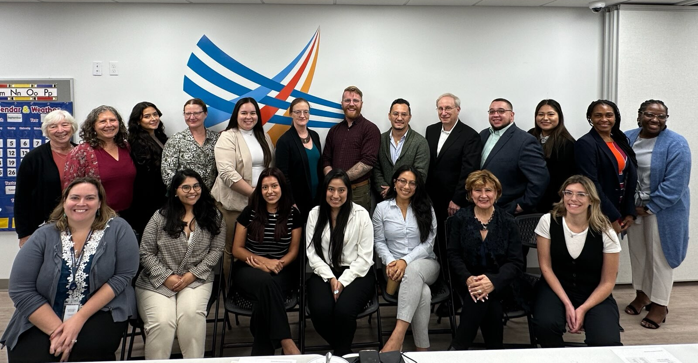
Strengthening Our Structure to Better Serve
Staff expansion and growth
Creation of opportunities:
  professional development
  program development

Slide 4
Building Capacity Through Program Innovation
  Deeper Engagement, Higher-Quality Volunteer Work
  SWOPE interns: now 3x/week, fully in-person
  Pro Bono Scholar from Pace Law, 2nd year
  NYS Attorney Emeritus Program host organization
Notes:
Deeper Engagement, Higher-Quality Volunteer Work
SWOPE restructure: We moved from 5 days a week (2 hybrid) to 3 days a week, fully in-person. Intensity and quality have both gone up. Interns now work together to meet the more detailed legal requirements for asylum filings, which helps prevent pretermission. Two SWOPE interns are staying on as year-round volunteers, including one from Albany Law School doing an internship for academic credit.
Pro Bono Scholar: This is our second year hosting a Pro Bono Scholar from Pace Law School, full-time from March through May.
NYS Attorney Emeritus Program: We are now an approved Host Organization. This supports our pro bono attorney practice and gives us a channel to post volunteer opportunities. Listing: https://www.nysattorneyemeritus.law/agency/detail/?agency_id=187662
Expanding Partnerships & New Practice Areas
Off-site FPP clinics: We continue to run 6–12 clinics a year and train local volunteers through grassroots community partners. FPPs now also include tips on self-advocacy in court and an analysis of detention risk.
Davis Polk: Firm volunteers staff EAD (employment authorization) clinics 6 times a year.
Akin Gump: We are presenting an immigration information session for first-year associates. Those associates can then put their required pro bono hours toward federal legal research projects that NLCLP legal teams design and use.
HSF Kramer: Anticipated 2d Cr. PFR for detained client via Open Arms, filed within 48 hours to prevent deportation to Afghanistan.
Federal habeas practice: We launched a federal habeas practice built on volunteer attorney support. We are now expanding into anticipatory pro se habeas, training volunteers to act quickly and accurately so jurisdiction is preserved in New York. Would be very effective rapid response to a raid. We can mass produce the Pro Se Habeas petitions for illegal arrests.
5th Circuit oral argument: We recently argued before the 5th Circuit in New Orleans, together with Akin Gump and pro bono attorney Tracy Stein. It was an exceptional opportunity to grow NL's skills and strengthen our partner relationships.
Montefiore partnership: We are partnering on a monthly half-day medical exam clinic, required as part of green card apps. Fees can reach $1,000, which is often out of reach for our clients. Primary care physician Dr. DeLuca is becoming a designated Civil Surgeon so he can complete these exams. He will accept insurance and waive fees that insurance doesn't cover. For uninsured clients, he will charge on a sliding scale down to $10.
Yeshiva University partnership: For the past year, William Salton, Ph.D. (Clinical Professor and Director of the Parnes Psychology Training Clinic), has provided pro bono forensic psychiatric evaluations for our clients with students in his Ph.D. course on asylum. Their interviews and reports are detailed and exceptional, and they significantly strengthen our asylum cases.
Specialized volunteer skills: We are drawing on volunteer expertise beyond the law. For example, a healthcare advocate who is a "Friend of NL" member helps clients fight medical bills and find insurance options. Another pro bono attorney is supporting client in IEP school advocacy.
Last year’s foundation includes the High School Senior Experience, standard weekly Monday volunteer day for Ossining FPP clinics and more. Weekly scheduled volunteers on other days who assist with data entry and paperwork.

Slide 5
Building Capacity Through Program Innovation
  Expanding Partnerships & New Practice Areas
  Off-site FPP clinics with community partners
  Law firm partner growth: Davis Polk, Akin Gump, Kramer
  Federal practice: habeas
  Montefiore: affordable I-693 medical exam clinic
  Yeshiva University: pro bono forensic psych evaluations
  Volunteer healthcare advocacy for clients
Notes:
Deeper Engagement, Higher-Quality Volunteer Work
SWOPE restructure: We moved from 5 days a week (2 hybrid) to 3 days a week, fully in-person. Intensity and quality have both gone up. Interns now work together to meet the more detailed legal requirements for asylum filings, which helps prevent pretermission. Two SWOPE interns are staying on as year-round volunteers, including one from Albany Law School doing an internship for academic credit.
Pro Bono Scholar: This is our second year hosting a Pro Bono Scholar from Pace Law School, full-time from March through May.
NYS Attorney Emeritus Program: We are now an approved Host Organization. This supports our pro bono attorney practice and gives us a channel to post volunteer opportunities. Listing: https://www.nysattorneyemeritus.law/agency/detail/?agency_id=187662
Expanding Partnerships & New Practice Areas
Off-site FPP clinics: We continue to run 6–12 clinics a year and train local volunteers through grassroots community partners. FPPs now also include tips on self-advocacy in court and an analysis of detention risk.
Davis Polk: Firm volunteers staff EAD (employment authorization) clinics 6 times a year.
Akin Gump: We are presenting an immigration information session for first-year associates. Those associates can then put their required pro bono hours toward federal legal research projects that NLCLP legal teams design and use.
HSF Kramer: Anticipated 2d Cr. PFR for detained client via Open Arms, filed within 48 hours to prevent deportation to Afghanistan.
Federal habeas practice: We launched a federal habeas practice built on volunteer attorney support. We are now expanding into anticipatory pro se habeas, training volunteers to act quickly and accurately so jurisdiction is preserved in New York. Would be very effective rapid response to a raid. We can mass produce the Pro Se Habeas petitions for illegal arrests.
5th Circuit oral argument: We recently argued before the 5th Circuit in New Orleans, together with Akin Gump and pro bono attorney Tracy Stein. It was an exceptional opportunity to grow NL's skills and strengthen our partner relationships.
Montefiore partnership: We are partnering on a monthly half-day medical exam clinic, required as part of green card apps. Fees can reach $1,000, which is often out of reach for our clients. Primary care physician Dr. DeLuca is becoming a designated Civil Surgeon so he can complete these exams. He will accept insurance and waive fees that insurance doesn't cover. For uninsured clients, he will charge on a sliding scale down to $10.
Yeshiva University partnership: For the past year, William Salton, Ph.D. (Clinical Professor and Director of the Parnes Psychology Training Clinic), has provided pro bono forensic psychiatric evaluations for our clients with students in his Ph.D. course on asylum. Their interviews and reports are detailed and exceptional, and they significantly strengthen our asylum cases.
Specialized volunteer skills: We are drawing on volunteer expertise beyond the law. For example, a healthcare advocate who is a "Friend of NL" member helps clients fight medical bills and find insurance options. Another pro bono attorney is supporting client in IEP school advocacy.
Last year’s foundation includes the High School Senior Experience, standard weekly Monday volunteer day for Ossining FPP clinics and more. Weekly scheduled volunteers on other days who assist with data entry and paperwork.

Slide 6
Taking it to the 5th Circuit Court
      A Roadmap for Federal Litigation

